Slide 1

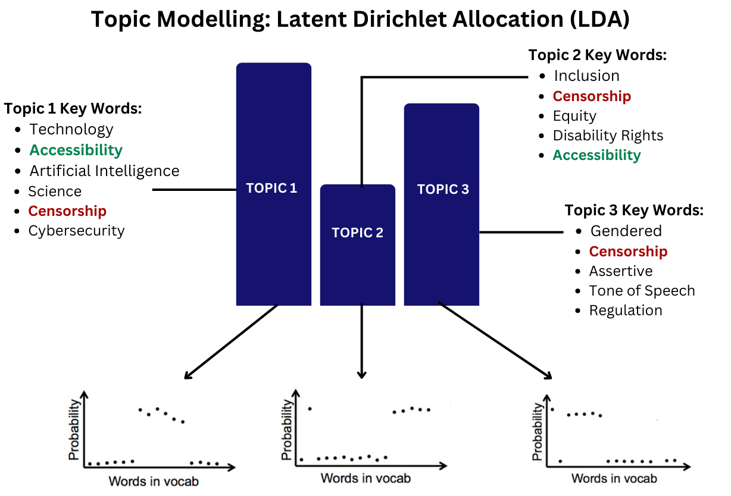
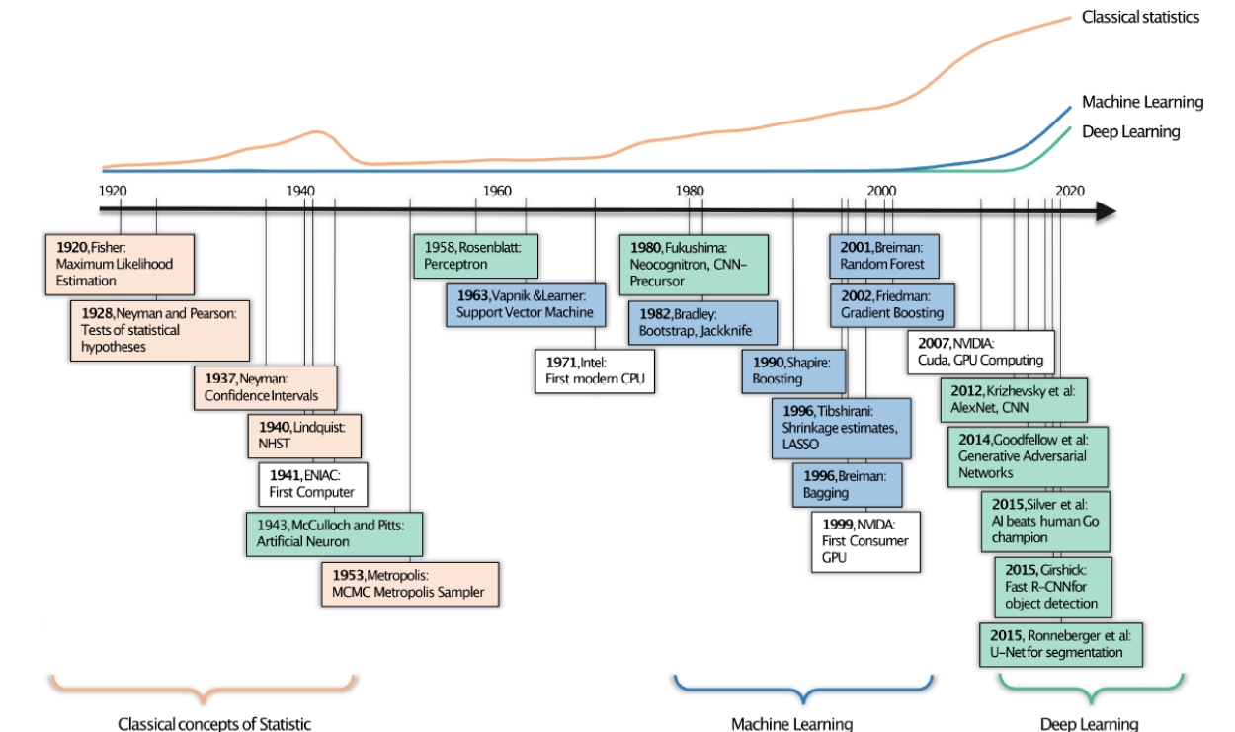

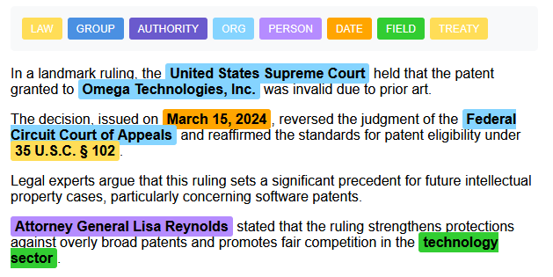
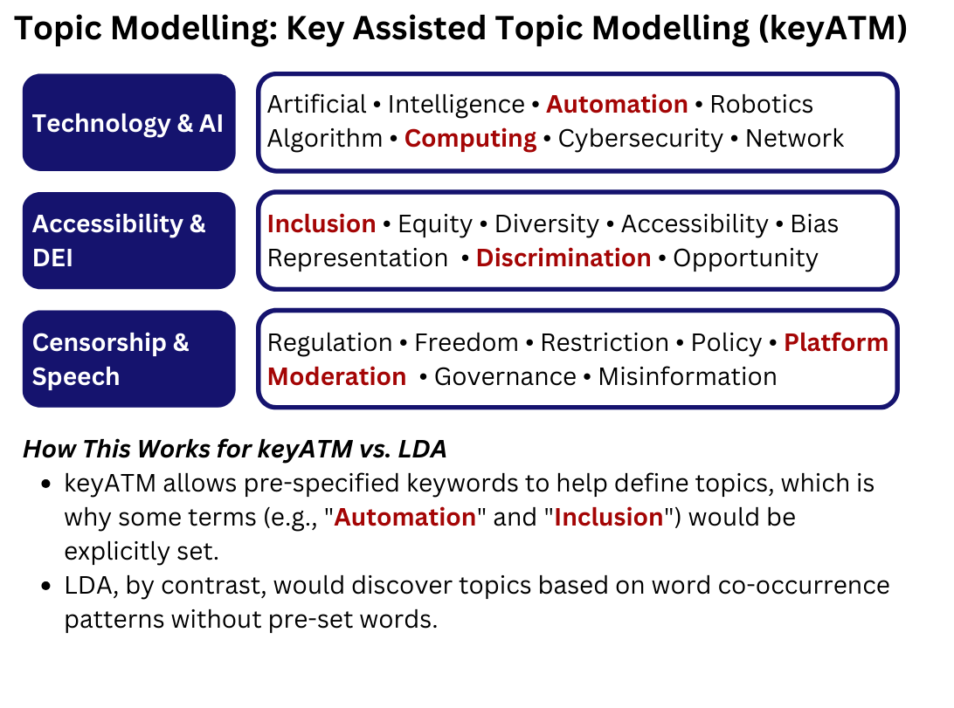
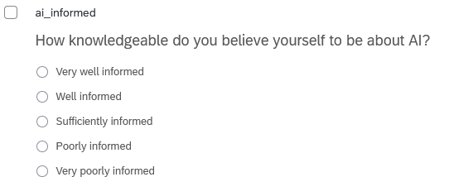
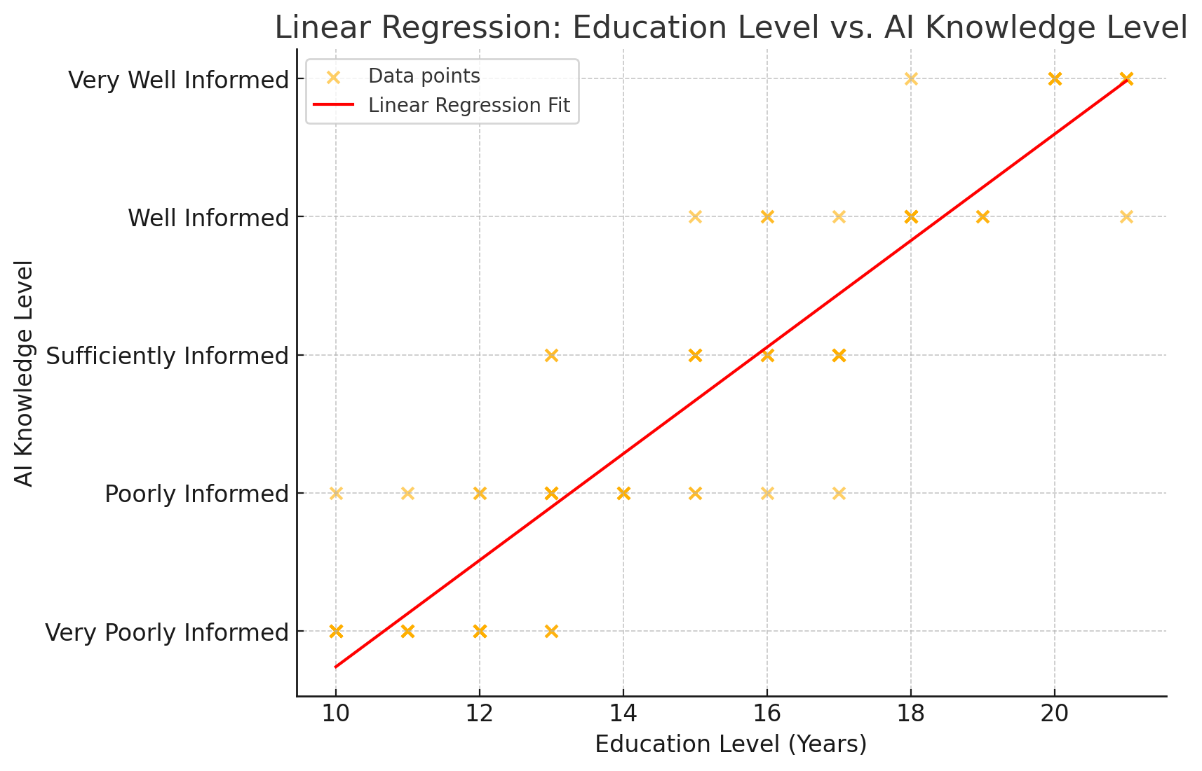
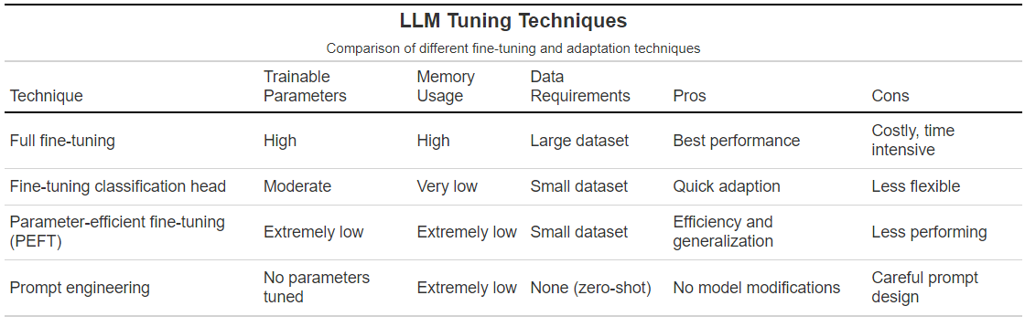

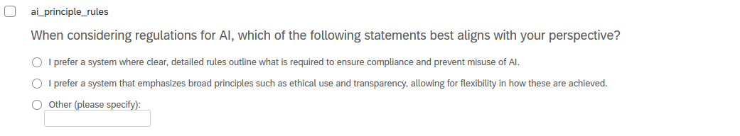
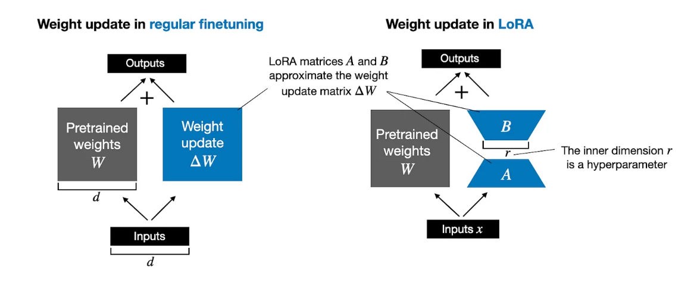
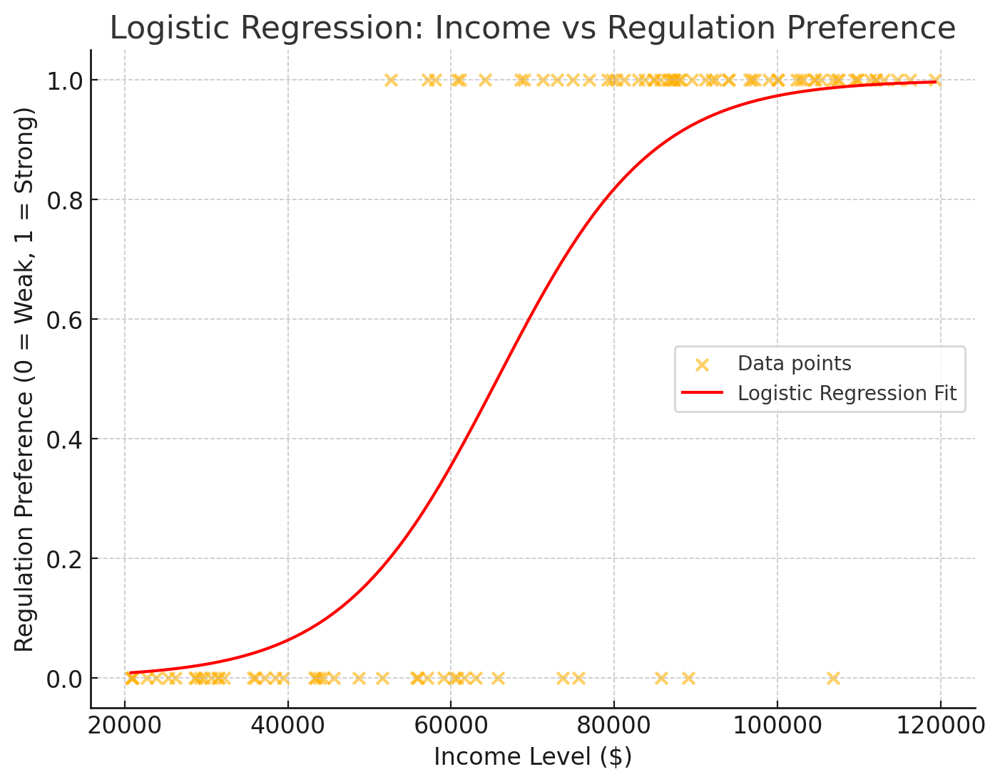

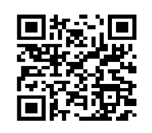
Department of Political Science
University of Toronto Scarborough
muhammadbin.amjad@mail.utoronto.ca
kira.jensen@mail.utoronto.ca
m.cowan@mail.utoronto.ca
Beyond the Text
Methodological Advances in Political Science Research
Amjad, M., Jensen, K., Cowan, M. (2025)
Introduction
Annotation & Labelling: From Manual to AI-Assisted
Topic Modelling
The computational revolution has transformed text analysis. Bayesian inference, machine learning, and Large Language Models (LLMs) now enable researchers to process vast amounts of textual data with unprecedented efficiency (Linegar et al., 2023).
We review these methodological advancements, illustrating how AI-driven tools enhance political science research.
For decades, political scientists have relied on hand annotation and manual coding to analyze qualitative data.
e.g., Analyzing open-ended question responses, or employing the Discourse Quality Index (DQI) traditionally required labour-intensive processes—making large-scale analysis challenging.
What can we do with labeled data?
Train supervised models for stance detection in political debates.
Use Name Entity Recognition (NER) to track policy discussions across time in the Canadian Hansard.
Automate discourse quality analysis in deliberative democracy research (Greenaway, n.d.)
Source: Fosse (2025)
Keyword-Assisted Topic Modelling
Classical Statistics: Regression (Survey Questionnaires)
Large Language Models (LLMs)
LLMs—AI systems trained on vast amounts of data to understand, generate, and manipulate human language—are the future of textual analysis (Spirling, 2023).
Adapting LLMs for specific tasks—like analyzing political texts or identifying policy trends—requires, at minimum, fine-tuning.
Using linear regression, we model the relationship between education level (years) and AI knowledge (self-report), for example.
β1 = effect of education level on AI knowledge.
ε is the error term.
Applicable Projects
Ctrl + Alt + Regulate (Cowan, Greenaway, Kallas, & Spahiu., n.d.)
Employs a mixed-methods approach to analyze 1,000 post-secondary student responses on AI regulation. We integrate keyATM to extract dominant themes in open-ended responses and utilize logistic regression to assess the relationship between demographic factors and preferences for principle-based vs. rules-based governance.
Under the AI-nfluence (Jensen, Amjad, Miles, & Cowan, n.d.)
Combining survey data and text analysis, this project employs a fine-tuned quantized LLM to classify and interpret students’ written rationales regarding AI’s impact on their careers.
Disability Politics in Political Science Pedagogy (Greenaway & Cowan, n.d.)
To map the representation of disability in political science curricula, this study applies comparative computational text analysis on a cross-national dataset of syllabi and textbooks. keyATM uncovers how disability politics is framed (e.g., social welfare vs. rights-based), while text classification models quantify its inclusion relative to other political issues.
Adapted from: Maerz (2025)
Using logistic regression, we model the likelihood that a respondent prefers principle-based AI governance vs. rule-based governance by income level ($), for example.
Y (dummy) = preference for principle-based regulation (1 = Strong, 0 = Weak)
β1 = effect of income level on preference.
Source: Hu et al. (2021)
References
Acknowledgements
Eshima, S., Imai, K., & Sasaki, T. (2024). Keyword‐assisted topic models. American Journal of Political Science, 68(2). https://doi.org/10.1111/ajps.12779
Hu, E. J., Shen, Y., Wallis, P., Allen-Zhu, Z., Li, Y., Wang, S., & Chen, W. (2021). LoRA: Low-rank adaptation of large language models. arXiv (Cornell University). https://doi.org/10.48550/arxiv.2106.09685
Linegar, M., Kocielnik, R., & Alvarez, R. M. (2023). Large language models and political science. Frontiers in Political Science, 5. https://doi.org/10.3389/fpos.2023.1257092
Spirling, A. (2023). Why open-source generative AI models are an ethical way forward for science. Nature, 616(7957), 413–413. https://doi.org/10.1038/d41586-023-01295-4
Törnberg, P. (2024). How to use large-language models for text analysis. SAGE Publications Ltd. https://doi.org/10.4135/9781529683707
Join the UTSC Methods Hub discord: https://discord.gg/N4edY2J5
Follow SDAC’s GitHub repository: https://github.com/PSSA-SDAC/sdac
Look for CCR-Accredited Data Workshops in Fall 2025.

